Slide 1
Section 8.4
Area of a Triangle

Slide 2


Slide 3
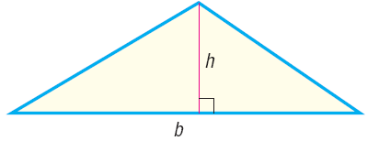
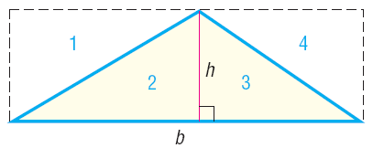

Slide 5
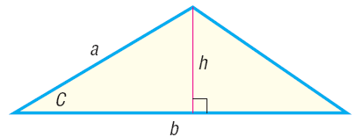

Slide 6



Slide 8
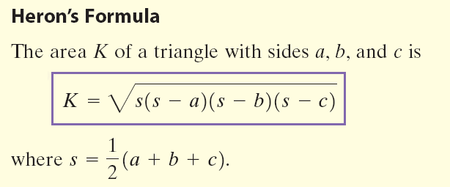

Slide 9
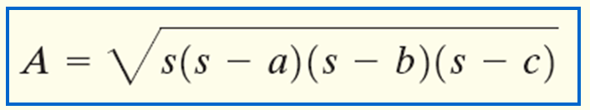
Find the area of a triangle whose sides are 3, 5, and 6.

